Slide 1
Team presentation-4 NTCIR-15 Dialogue Evaluation Task
組員 : 黃彥鈞、黃顗亘、鄭宇雅、廖容毅

Slide 2
Summary
In the last presentation, we solve the multi-label problem and generate the 7-label one hot version of the prediction.
About this week’s goal, we are going to calculate the difference between the prediction and the ground truth, since our prediction is complicated, it is hard to output the performance through a single model.
In this presentation, we will introduce the method to calculate the difference between probability distribution, known as Jensen-Shannon divergence (donated as JSD) and Root Normalize Sum of Squares (donated as RNSS)
And we will talk about the problem we are facing about wrong researching direction in this 2 weeks.

Slide 3
Outlines
How to calculate the difference between probability distribution?
Problem of current progress
Further research direction

Slide 4


How to calculate the difference between probability distribution? I
JSD
In probability theory and statistics, the Jensen–Shannon divergence is a method of measuring the similarity between two probability distributions. It is also known as information radius (IRad) or total divergence to the average. It is based on the Kullback–Leibler divergence, with some notable (and useful) differences, including that it is symmetric and it always has a finite value. The square root of the Jensen–Shannon divergence is a metric often referred to as Jensen-Shannon distance.

Slide 5


How to calculate the difference between probability distribution? II
RNSS
The sum of squares is a tool statisticians and scientists use to evaluate the overall variance of a data set from its mean. A large sum of squares denotes a large variance, which means that individual readings fluctuate widely from the mean.

Slide 6
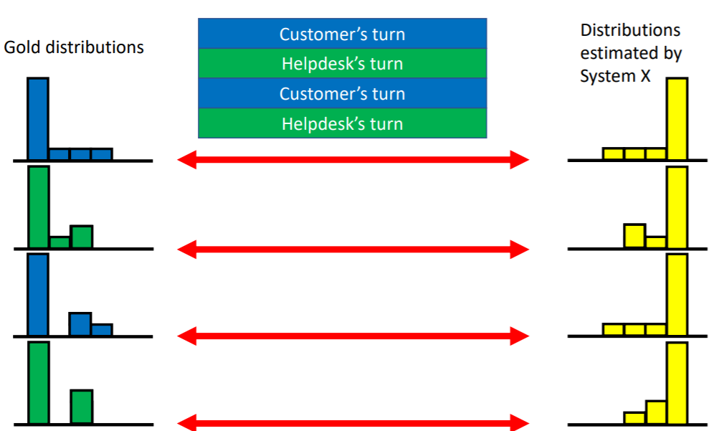
Problem of current progress I
Our method
Competition’s method
features
0110010
features
0101000
features
0000010
JSD
RNSS
JSD
RNSS

Slide 7
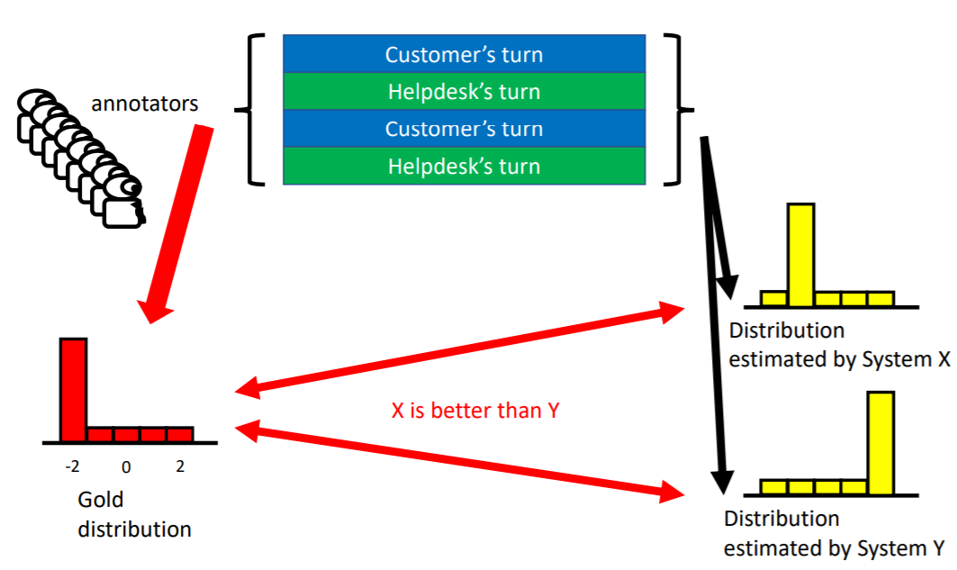
Problem of current progress II
So… What’s difference?

Slide 8
Further research direction
First, we have to test if the baseline pack of evaluation method released from DialEval team is as same as the current method (SciPy)
Second, we decided to find out a way that can
let dnn model generate the probability distribution
extract them from a specific layer output.
One way we are planning to try is to customize the loss function to replace ir in the model.compile() function.

Slide 9
Thanks for listening!

